Slide 1

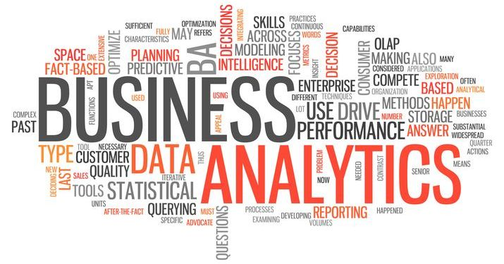
PHARMA DATA/BUSINESS ANALYTICS PROJECT
Data Collection
Data Cleaning
Table(columns) Merging
Pivot Tables formation
KPIs highlighted
Various graphs visualized
Business Insights drawn out
Reporting Done
- Sumit Sinha
- https://www.linkedin.com/in/sumit-sinha-454a232a6/

Slide 2
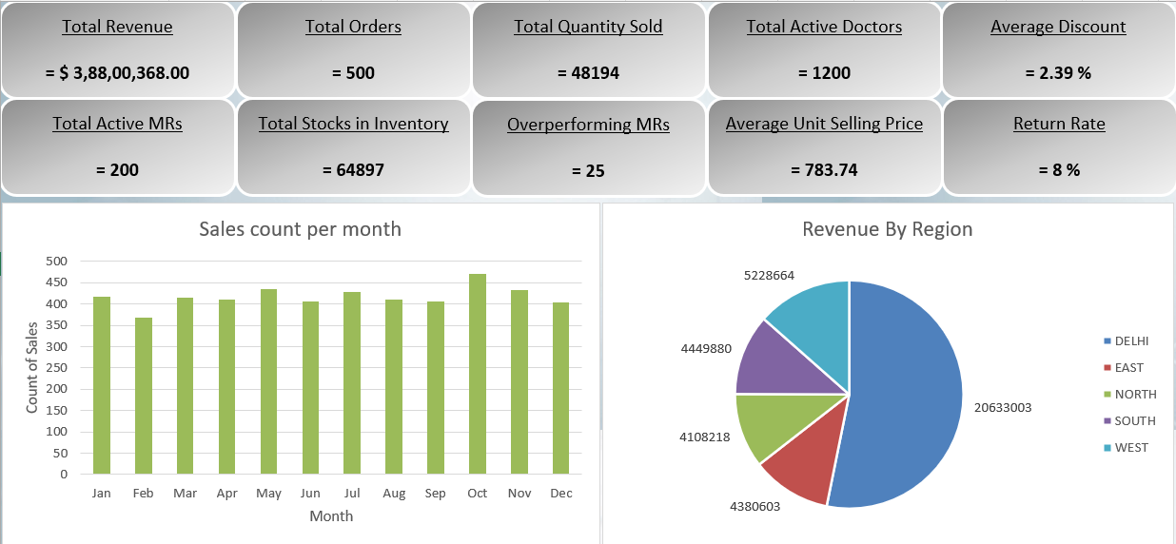

Slide 3
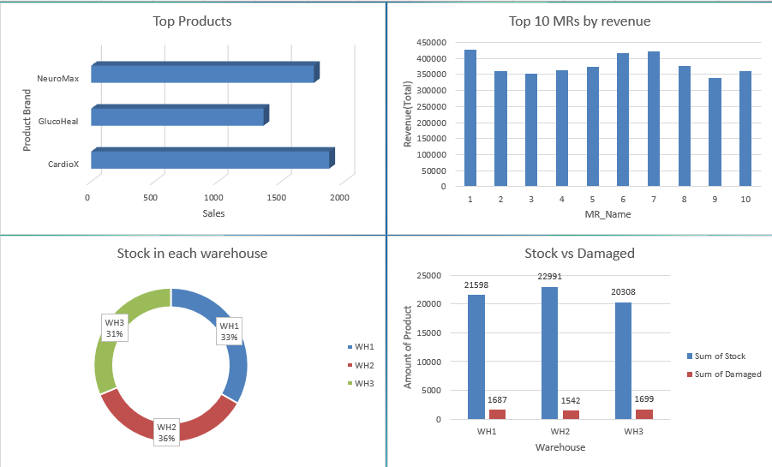

Slide 4
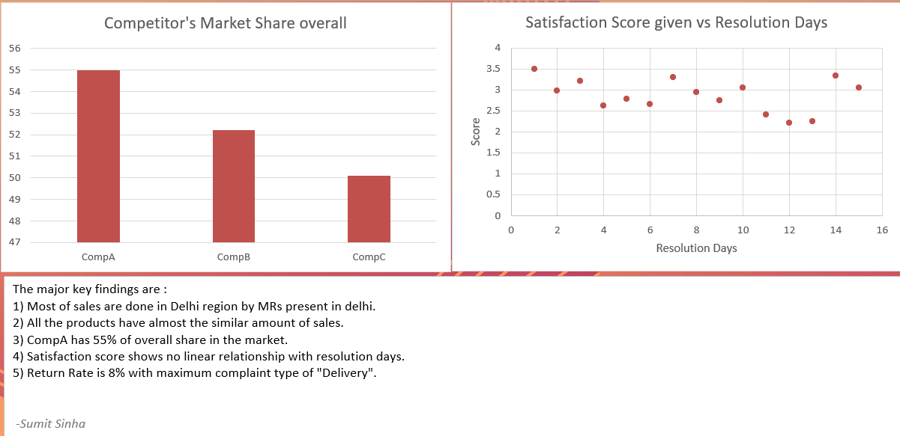
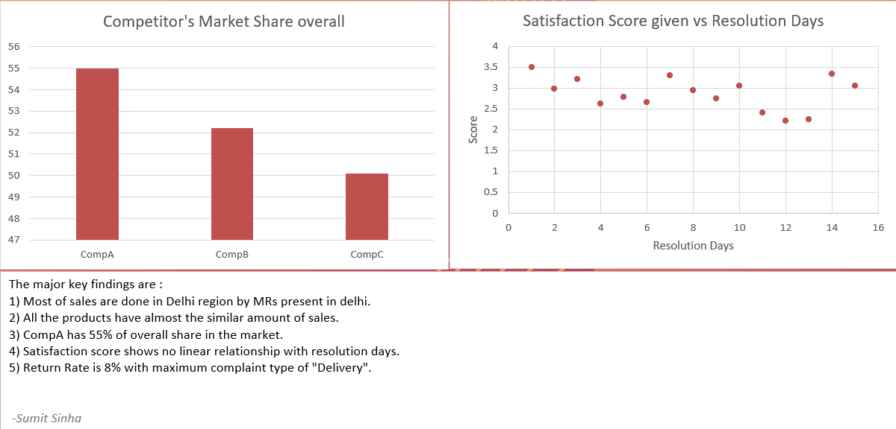

Slide 5


